Slide 1
First Intermediate Presentation Master Thesis: Vision based Indoor Navigation of an Unmanned Aerial Vehicle.
Under the guidance of: Holger Dieterich
Presented By: Saurabh Mandlik(11013278)

Slide 2
Content
System Overview
Object Detection Pipeline
Milestones
Result
Future work

Slide 3
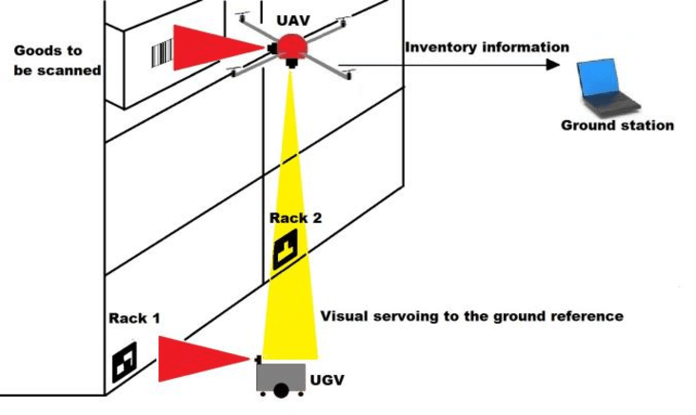
System Overview
Barcode to be scanned
Main Steps Involved:
Visual fiducial marker based localization in 3D (x, y, yaw)
Flight controller configuration to enable position and height control
Object detection to determine new relative target position
Automatize position control for target positions
Ground robot vehicle

Slide 4
Object Detection Pipeline:
Relative Pose
Estimation
Camera
node
Image Topic
Detect
shape
Object
Co-ordinates
Simple Shape Detection
Object detection with deep learning

Slide 5
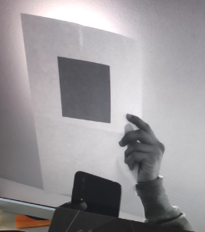
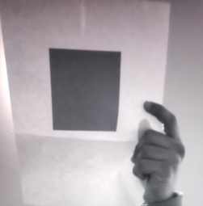
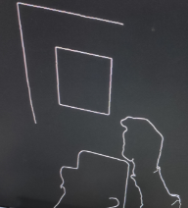
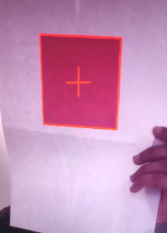
Simple Shape Detection:
Gray Image
Blurred Image
Edged
Object detected

Slide 6
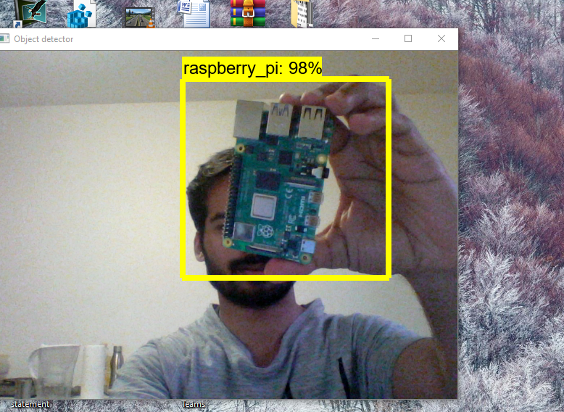
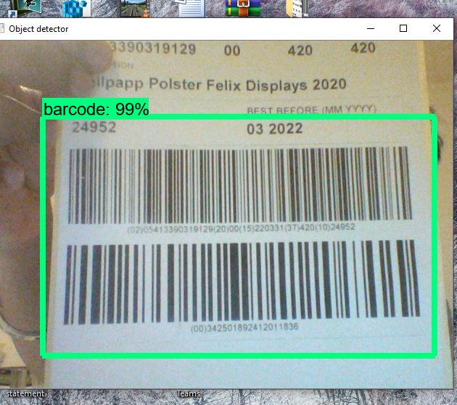
Object Detected Using Deep Learning

Slide 7
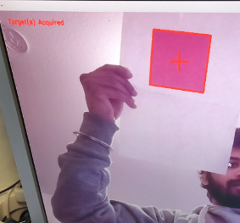
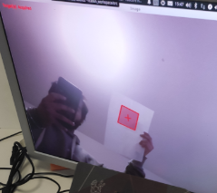
Result:

Slide 8
Future Work
Flight controller configuration
Manual test flight with simple shape detection
Automatized flight detecting simple shapes
Replace simple shape detection with deep learning object detection

